Slide 1
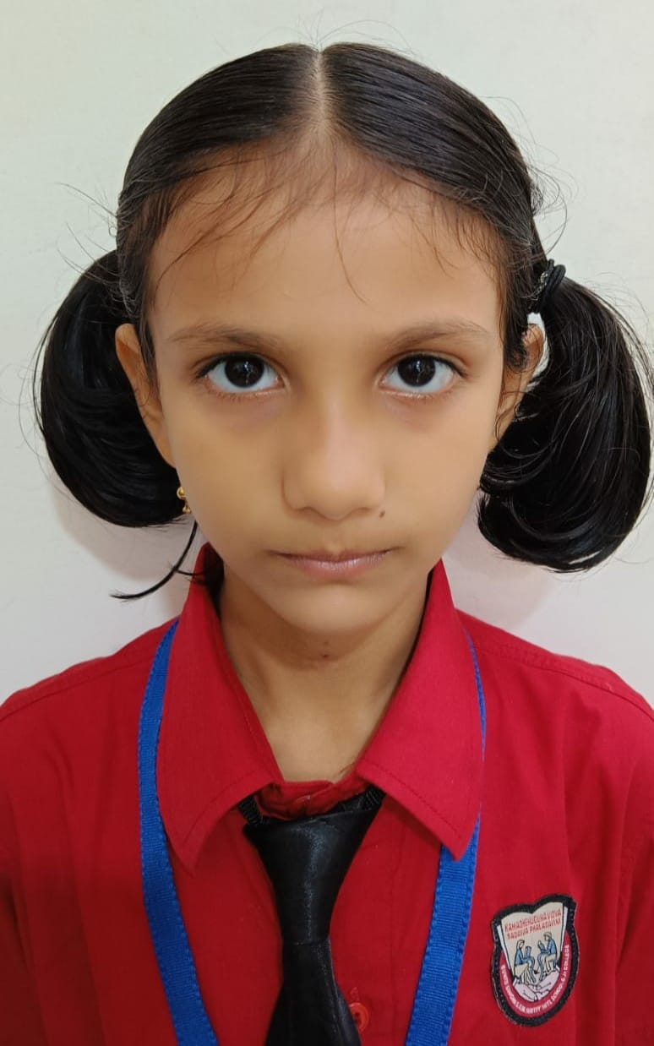
Miss Aarna Thakur studying in CP 2C participated in MSSA chess tournament and she ranked 22nd out of 80 girls and she played 7 games and won 4 out of them.

Slide 2
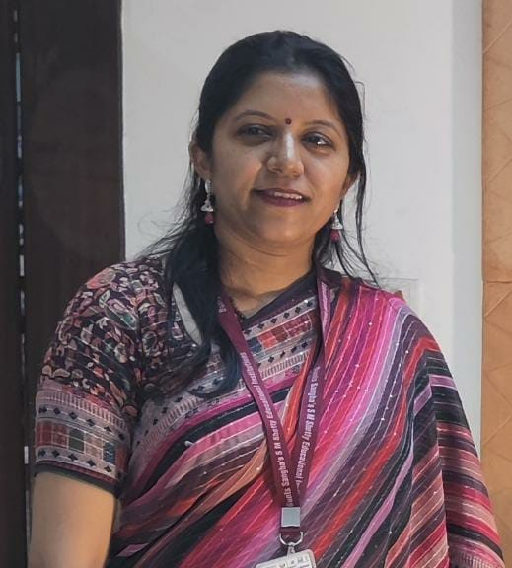
Our faculty Ms Nitya Chhatpar won the Best Formative assessment award in the TTF contest held across India by the teachers foundation organization

Slide 3
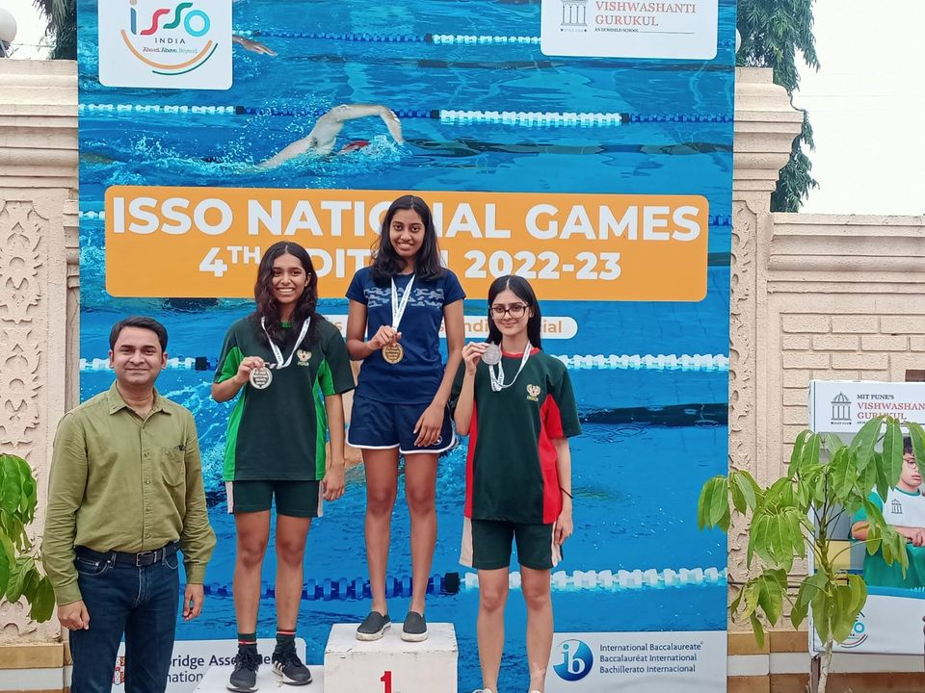
Riddhima Pradhan from IGCSE I has won accolades at the Cambridge International Schools Sports Organization (ISSO).She won the Gold medal in the 200m freestyle Girls category and won the Bronze in the 100m Breaststroke Girls category.

Slide 4
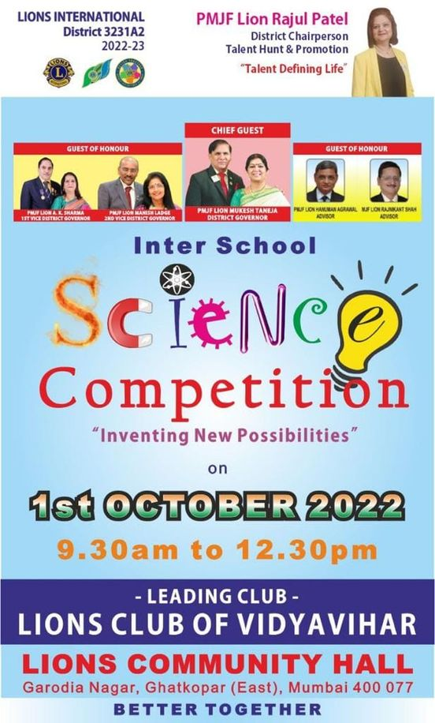
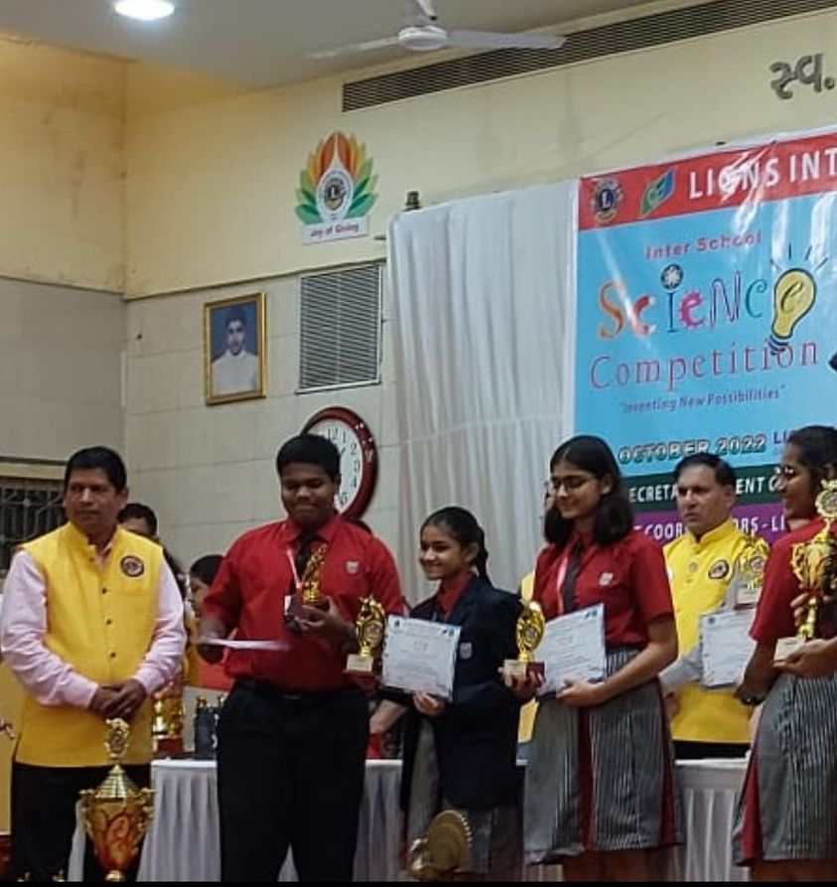
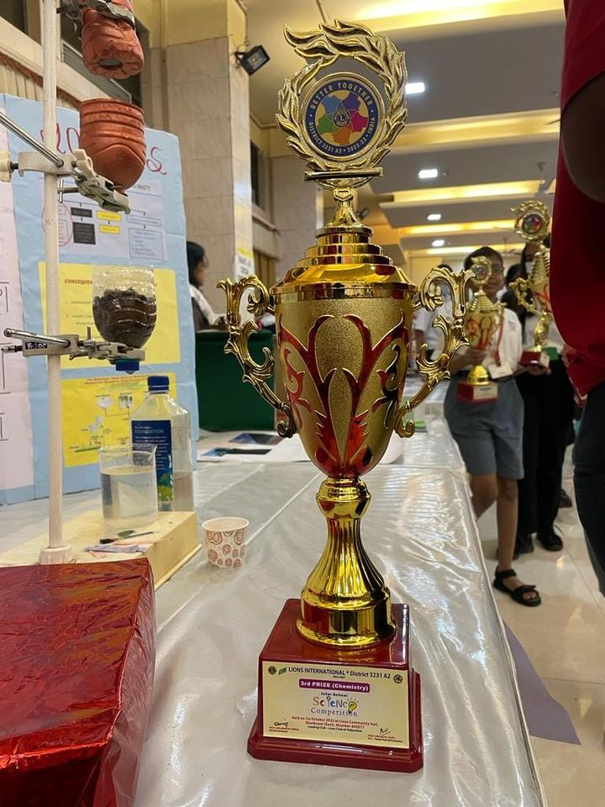
Our students Sarah Ann Menezes, Kiranmayee Lade, Divya Daga and Sanskar Nagral from IGCSE I won the third position at the Interschool Science Competition conducted by Lion's Club of Vidyavihar on 1st October in the Chemistry category mentored by our Chemistry faculty Ms. Vaishali Khedekar. They presented a WATER TREATMENT PROJECT for grey water management.

Slide 5
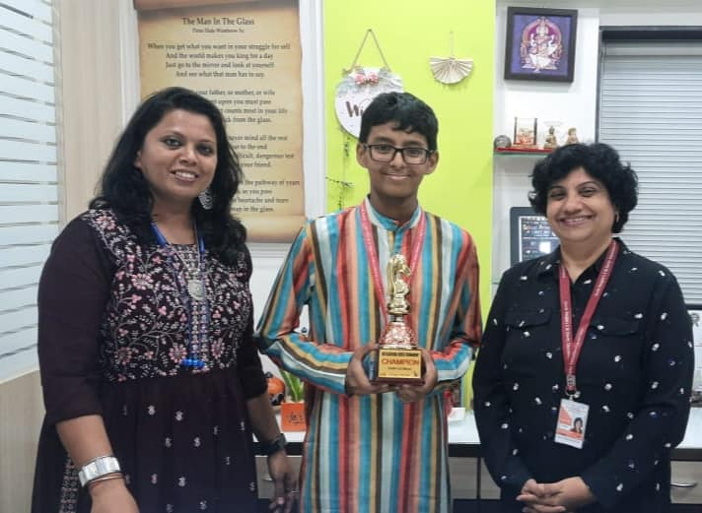
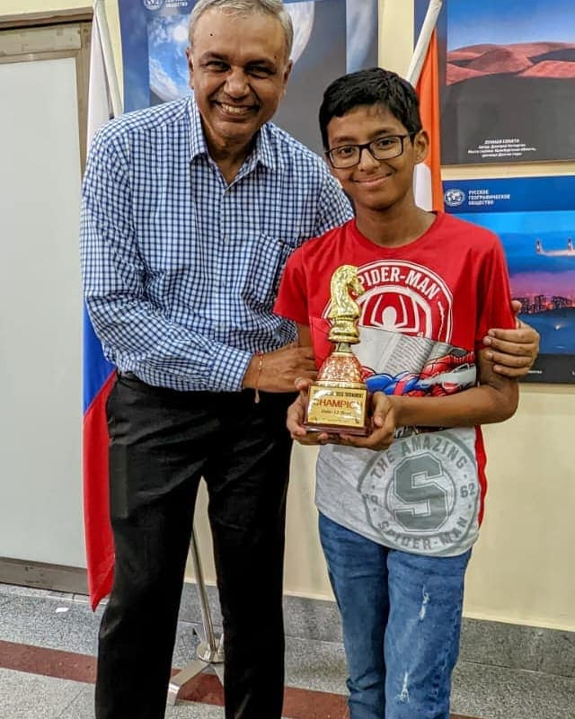
Checkpoint II student Ishan Roy won First prize in ICS classical tournament, U12 boys category and in 3 days classical chess tournament, he got 5.5/8. He also secured fifth place in Pinnacle Chess Fest 2022, August 28, 2022 under U-15 category. He has achieved the 9th position from among the 385 participants in the Mumbai Schools Sports Association under 14 Boys Chess Tournament.

Slide 6
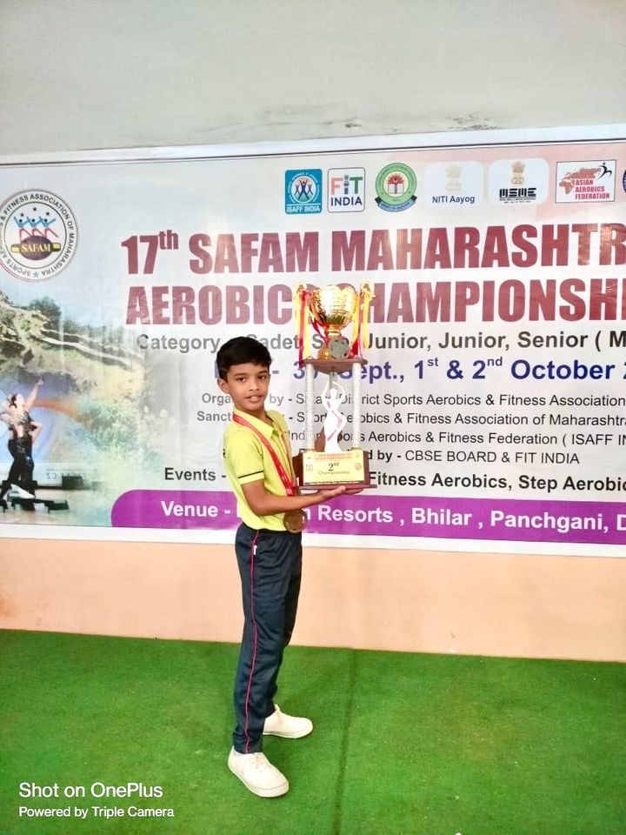
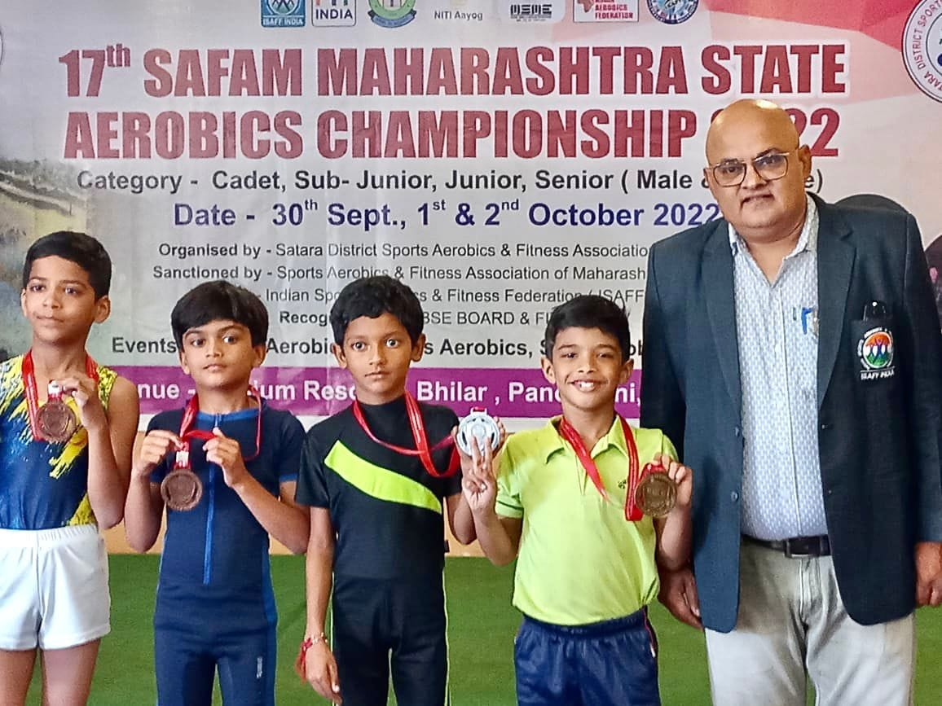
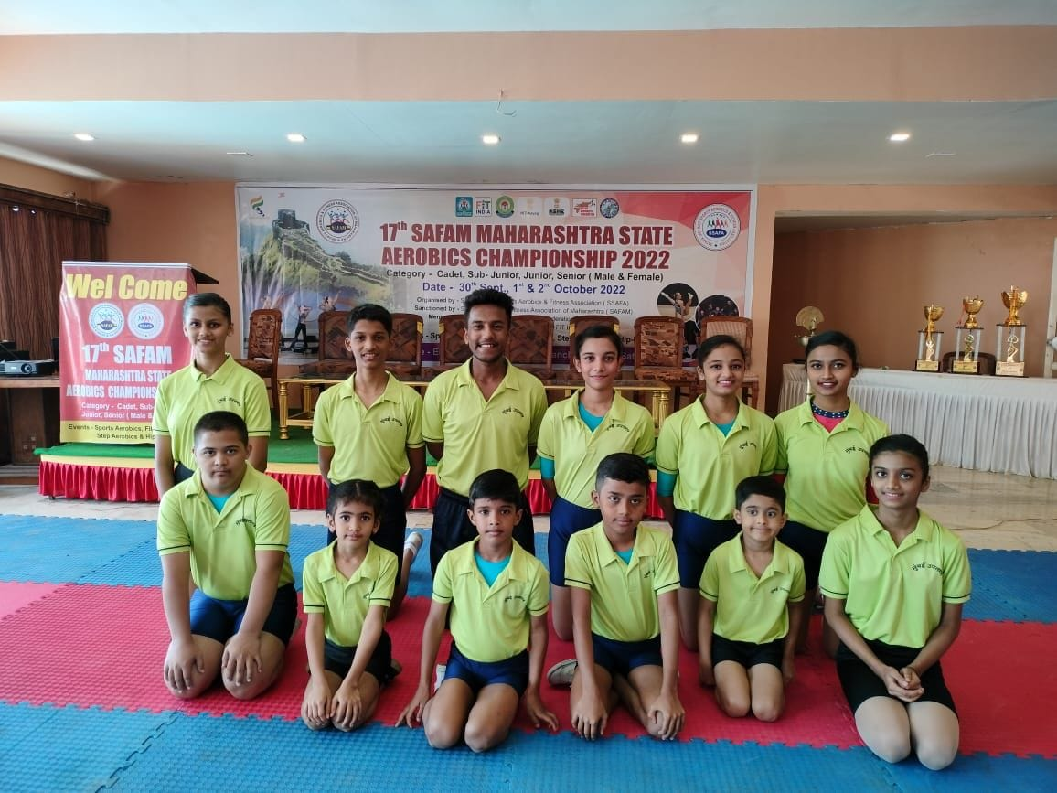
In 17th SAFAM Maharashtra State Aerobics Championship 2022 held in Bilhar Panchgani held from September 20 to October 2, 2022, our student Ayaan Ram participated in 4 events and won 4 Gold medal.

Slide 7
Our School is selected in the Top 5 school from 90+school across India. Sagarika Gupta won second position in 6th – 8th Grade in category of “Paint India” organized by FairGaze a colloboration between India and Bhutan

Slide 8
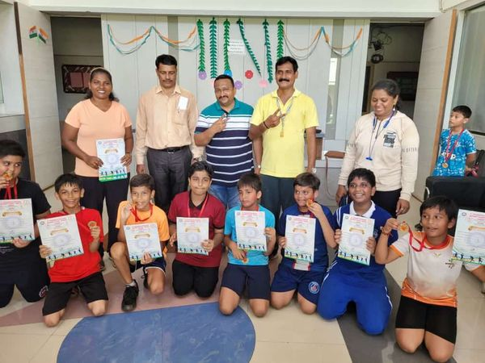
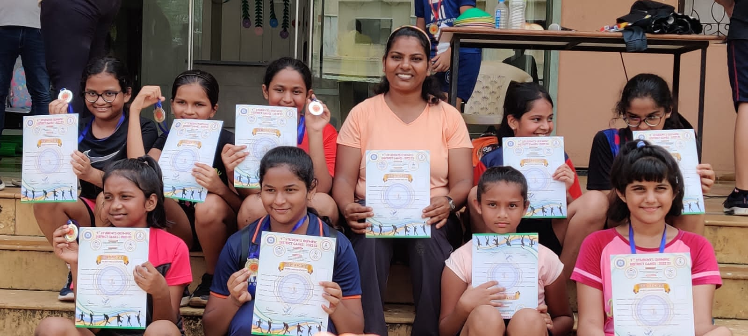
First place in the U12 Boys and second place in the U12 Girls Handball Tournaments organized by the DISTRICT OLYMPIC GAMES Competition & Selection Trials for 2022-2023

Slide 9
Handball Coach Ms. Rekha Kamble was felicitated by the Cabinet Minister Mr. Anurag Thakur for representing our country as the Captain of the Indian team at the Asian Beach Handball Tournament held in April 2022 in Thailand. Ms. Rekha has also represented the Indian team and the Maharashtra State team.

Slide 10
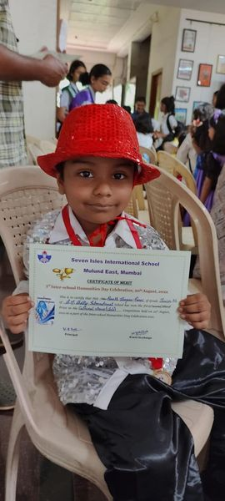
Yagna Palliwal and Yahvi Mange of IEYC III bagged third position in ACS fest hop2022-2023

Slide 11
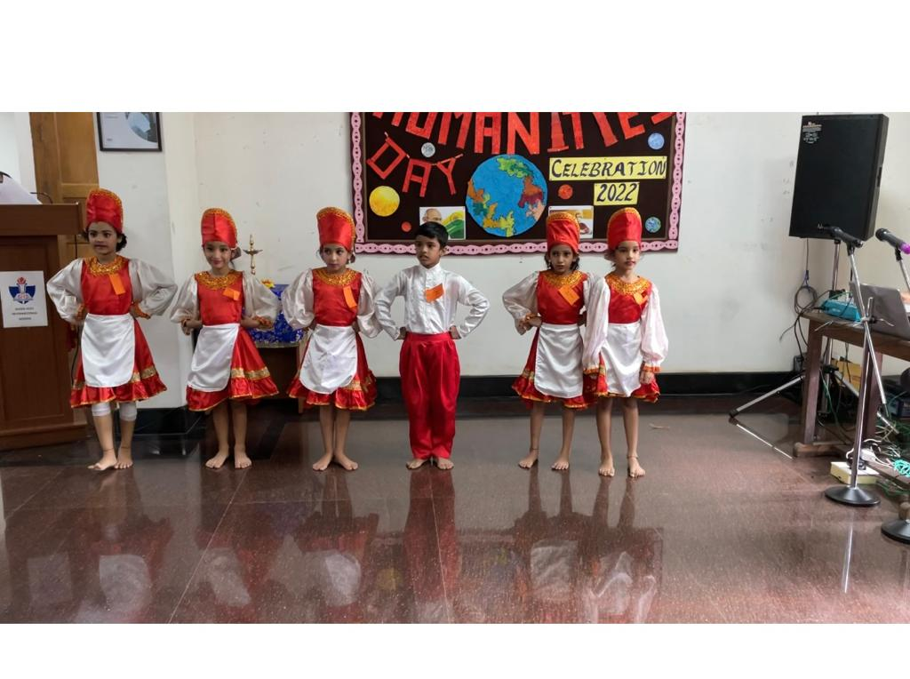
Our students won 6 awards at the “Interschool Humanities Day Celebration” held at Seven Isles School.

Slide 12
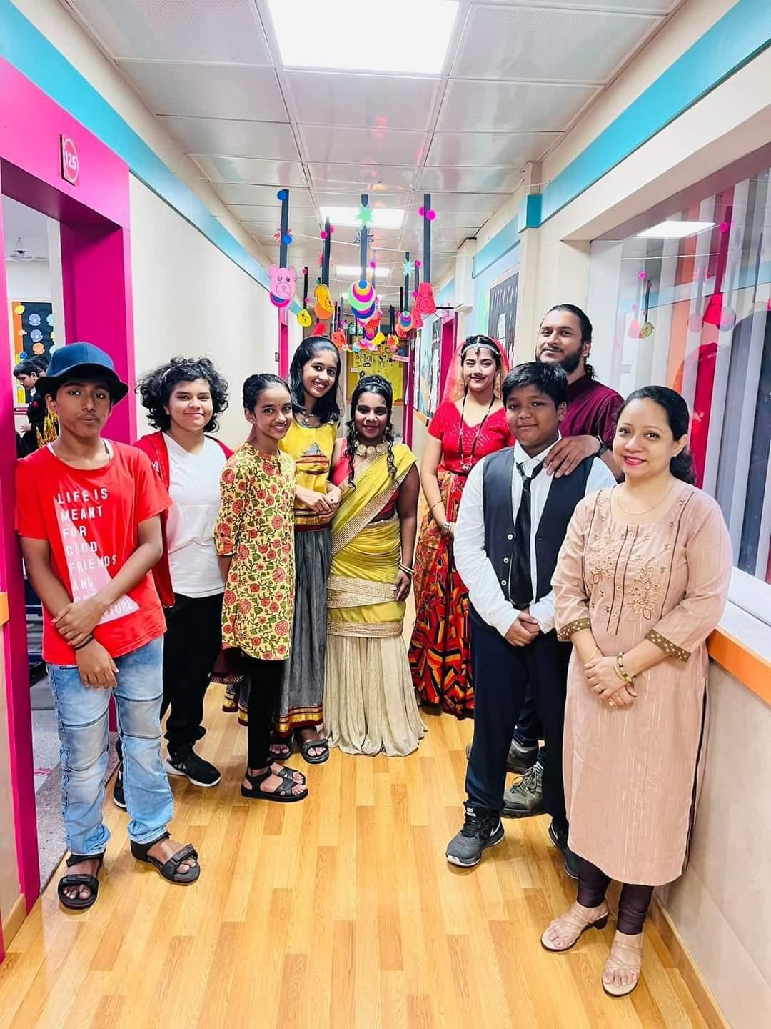
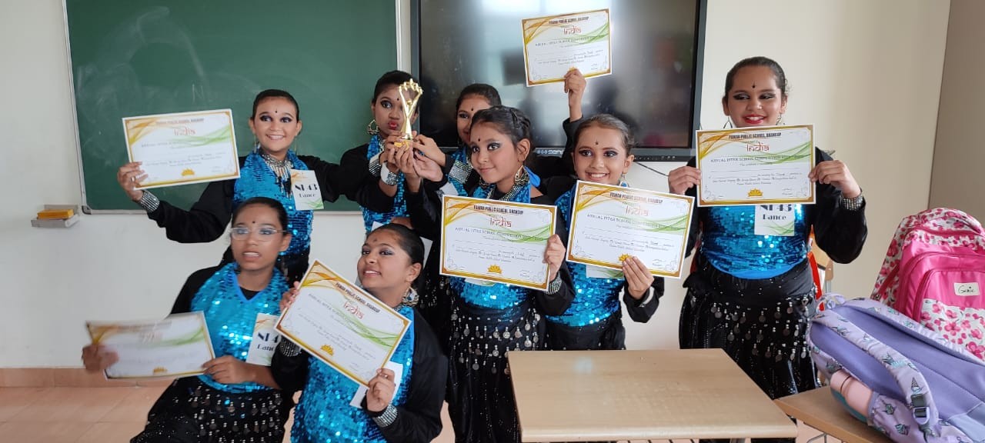
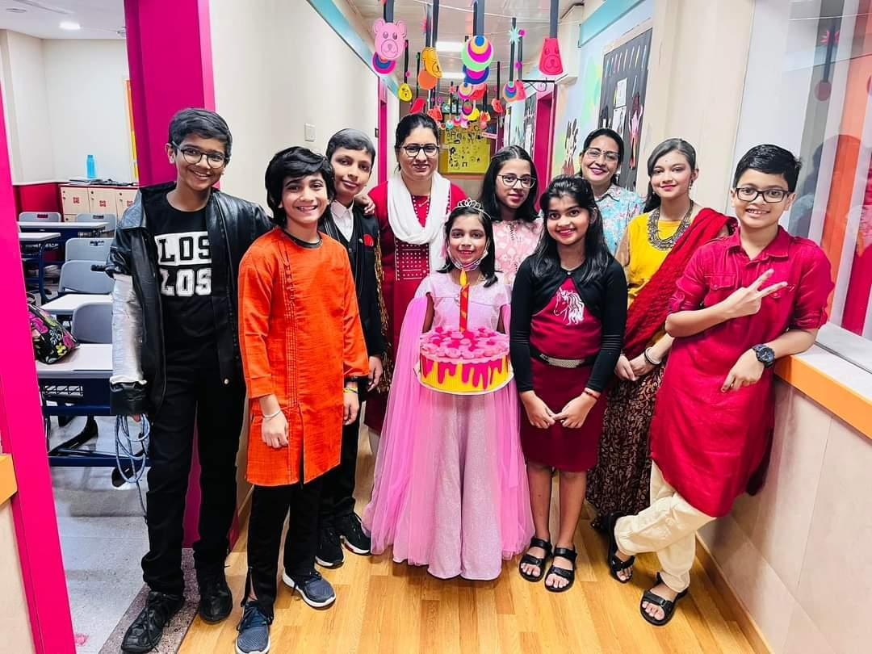
NAMASTE INDIA – 3rd position –Dance Competition

Slide 13
Ishan Roy of Checkpoint II D (Grade 7) secured fifth place in Pinnacle Chess Fest 2022, under U-15 category.

Slide 14
Students and teachers were felicitated by Rotary club for their outstanding performance in the board years. Ms Tahira Pasha, Ms Jolly Francis and Mr Gurvinder Singh were honoured for their contribution to student performance and development.

Slide 15
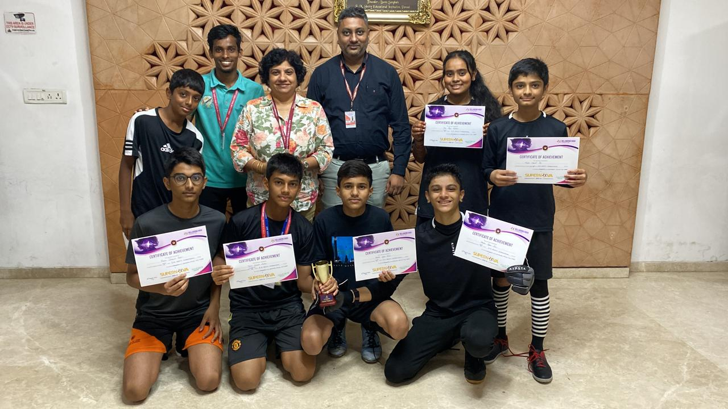
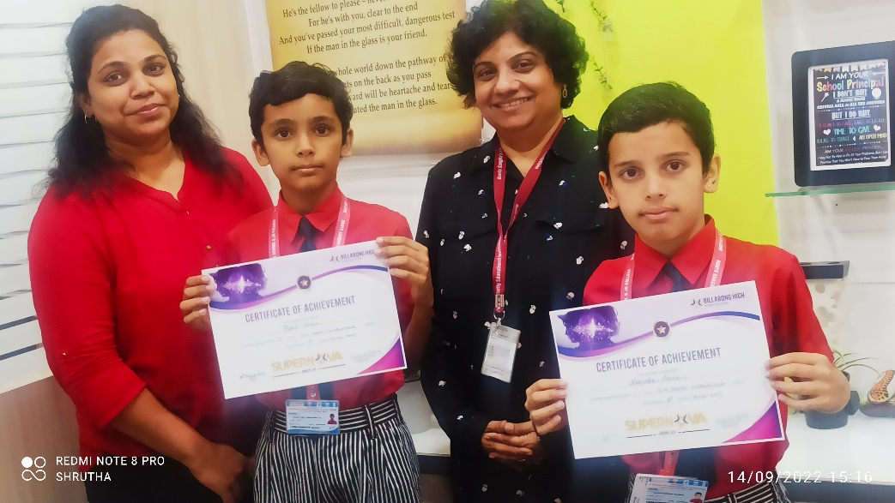
Supernova Sports Competition at Billabong, Juhu

Slide 16
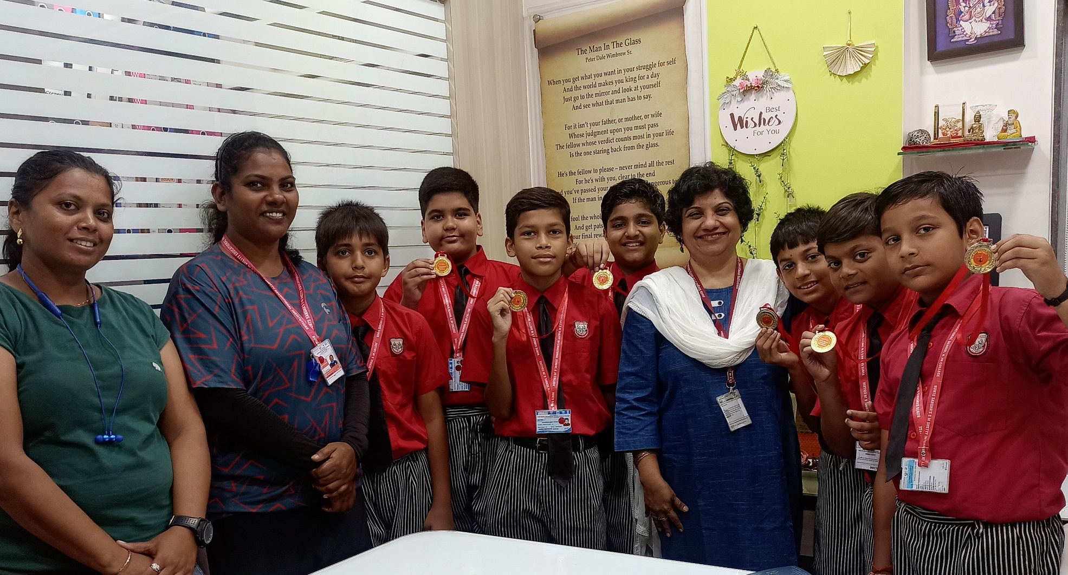
Supernova Sports Competition at Billabong, Juhu

Slide 17
Principal Ms. Mildred Lobo has successfully completed the training program IMC RBNQA - Certied Examiner for Quality Management She has also been elected as the MISA Executive Committee member for the academic year 2022.

Slide 18
Ms Huzaifah Bhaldar has officially been welcomed as a 2022 Climate Action Project Facilitator! She will join a global team of about 120 facilitators to share her expertise and provide facilitation to teachers participating in the Climate Action Project 2022.

Slide 19
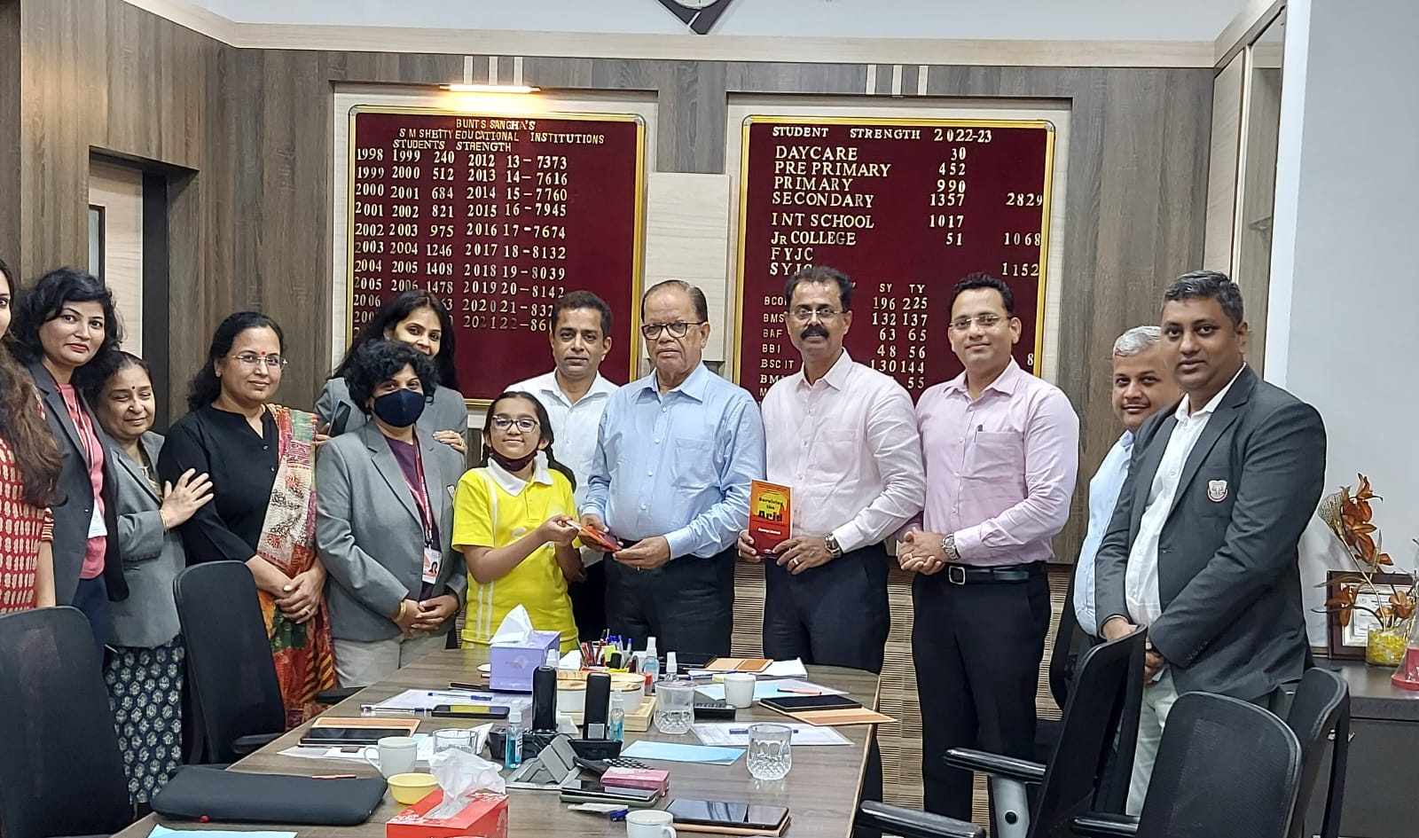
Ananya Harish, a budding author had her first book launched on Sunday, 3rd July.

Slide 20
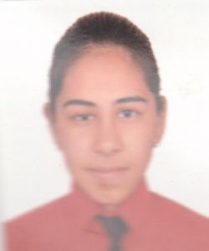
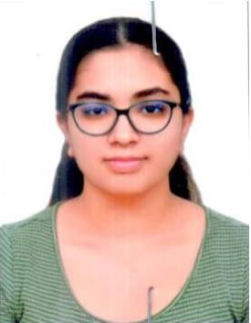
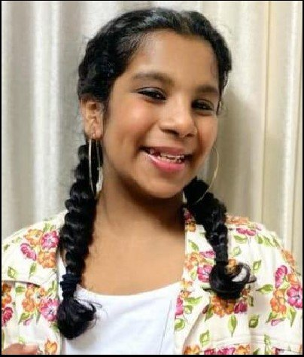
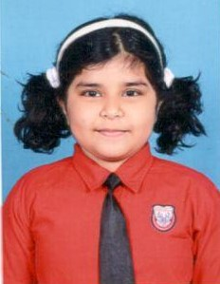
Aarush Bathula, Vaanya Sharma, Trisha Saini, Om Menon, Megan Salian are the winners at Fairgaze MUN

Slide 21
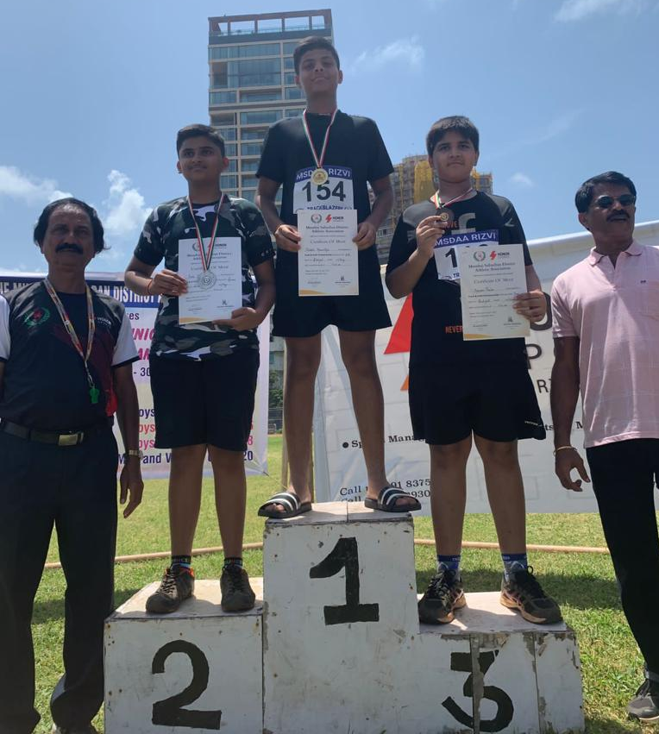
In the Athletics Competition organized by MSDAA (Mumbai Suburban District Athletic Association) on July 30th and 31st, 2022, Harshil Khanvilkar , Checkpoint III (Grade 8) student secured two Gold Medals in Ball Throw and in Shot Put.

Slide 22
In the Athletics Competition organized by MSDAA (Mumbai Suburban District Athletic Association) on July 30th and 31st, 2022, Mahi Shukla, AS level student secured bronze medal in Discus throw

Slide 23
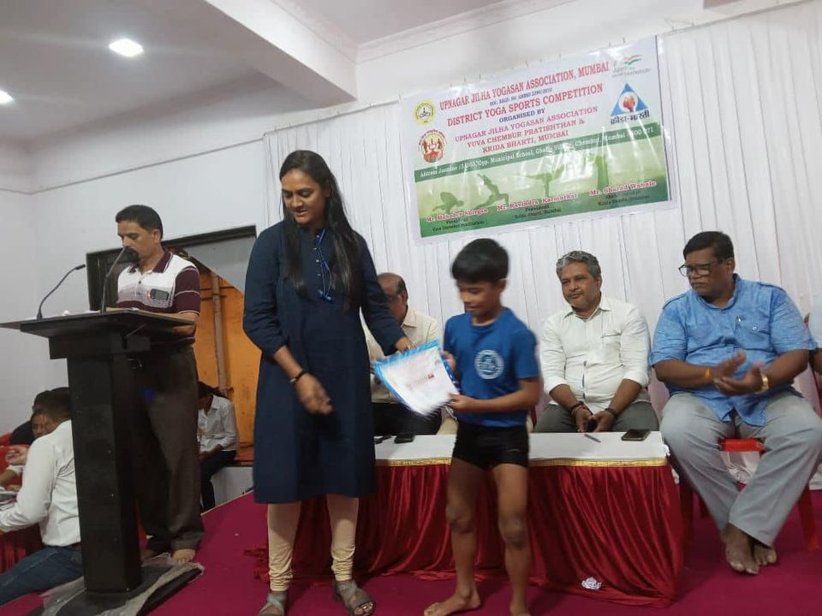
Ayaan Ram, CP III (Grade3) student, achieved 4th position in District Yoga Sports Competition organized by Upnagar Jilha Yogasan Association, Mumbai.

